Slide 1
Credit Risk Modelling
Phase 1
23-07-2024
Lauki Finance

Slide 2
Project Objective & Success Criteria
Objective: Build a Model that a Risk Unit can use to measure credit risk
Success Criteria:
AUC, Gini > 85
KS statistic > 40
Max KS stat in first 3 deciles
Model interpretation

Slide 3
Train and Test Dataset
Source: Past two year’s loan data from Lauki Finance
Feb 2022 to Feb 2024
Mar 2024 to May 2024
Training and Validation
Out of Time

Slide 4

Features - Customers
Variables | Description
cust_id | Customer ID
age | Age of the customer
gender | Gender
marital_status | Marital Status
employment_status | Employment Status
income | Income of the Customer
number_of_dependents | Number of dependents
residence_type | Residence Type
years_at_current_address | Years at present address
city | City
state | State
zipcode | Zipcode/Pincode

Slide 5
Features - Loans
Variables | Description
loan_id | Loan ID
cust_id | Customer ID
loan_purpose | Loan Purpose
loan_type | Loan Type
sanction_amount | Sanction Amount
loan_amount | Loan Amount
net_disbursement | Amount Disbursed in Customer’s Account
loan_tenure_months | Loan Tenure in Months
principal_outstanding | POS (Principal Outstanding)/BookSize of Customer
bank_balance_at_application | Bank Balance at application
disbursal_date | Disbursed Date
installment_start_dt | Installment start date
default | Default / No Default

Slide 6
Features – Bureau Data
Variables | Description
cust_id | Customer ID
no_of_open_accounts | Total Number of open accounts till date
no_of_closed_accounts | Total Number of closed accounts till date
total_loan_months | Total Loan in months
delinquent_months | Total delinquent in months
total_dpd | Total Due passed day
enquiry_count | Total Enquiry count
credit_utilization_ratio | Credit Utilization Ratio

Slide 7
Significant Variables
Variable | IV | Inference
credit_utilization_ratio | 2.35 | Higher usage of available credit significantly increases default risk.
delinquency_ratio | 0.71 | Higher delinquency rates are strongly linked to increased default risk.
loan_to_income | 0.47 | Higher loan amounts relative to income increase the likelihood of default.
avg_dpd_per_delinquency | 0.40 | Higher days past due per delinquency correlates with higher default risk.
loan_purpose | 0.36 | Certain loan purposes are more likely to be associated with default.
residence_type | 0.24 | Residence type has a moderate impact on default risk.
loan_tenure_months | 0.21 | Longer loan tenures increases default risk.
loan_type | 0.16 | Different loan types have a minor influence on default risk.
age | 0.08 | Younger or older age has a minimal effect on default risk.
number_of_open_accounts | 0.08 | More open accounts can lead to default risk.

Slide 8
Modeling Steps
Dataset
Data Preprocessing
Train, Test Split
Customers
Loans
Bureau Data
Target: Default (Binary Variable)
Loan purpose invalid values replaced with a mode
Feature selection using IV, VIF, and domain knowledge
Min max scaling for numeric features
75 % - Training
25 % - Test
AUC, KS, Gini Coeff
Classification Report
RandomizedSearchCV
Optuna
Logistic Regression
XGBoost
Random Forest
Model Evaluation
Fine Tunning
Model Training

Slide 9
Trials and Performance
Models | AUC | Gini
Logistic Regression | 98 | 96
XGBoost | 99 | 96
Random Forest | 97 | 95

Slide 10
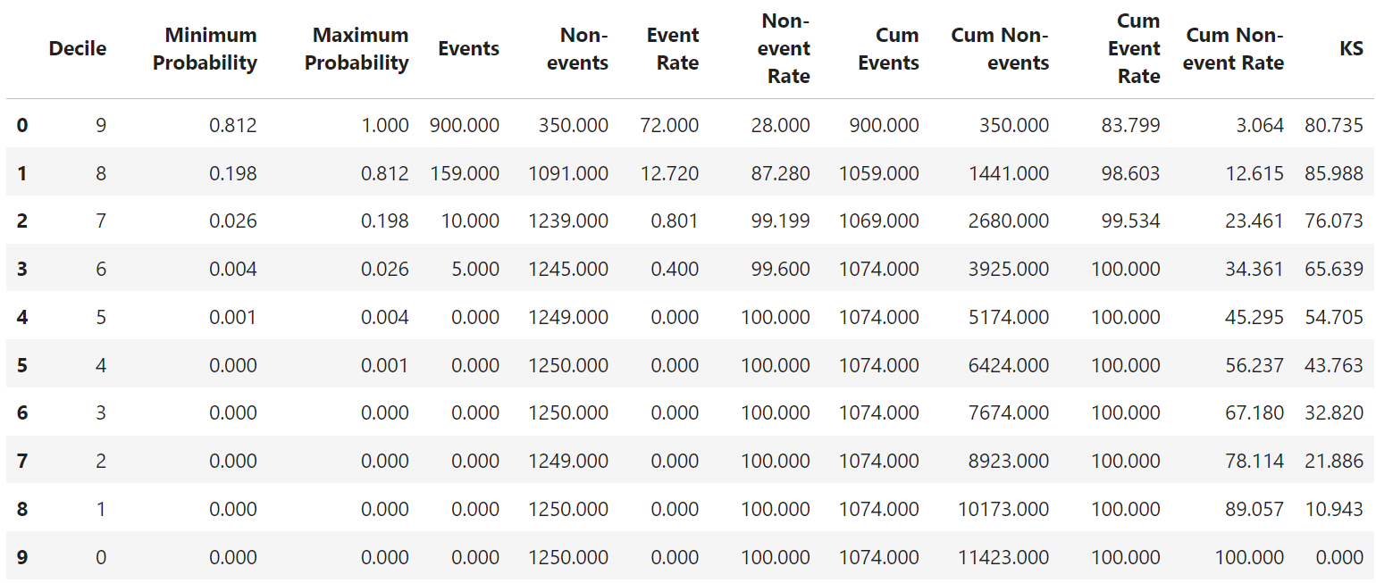

Model Evaluation
AUC | Gini | Top 3 Decile Capture Rate
98% | 96% | 99.53%

Slide 11
Questions?

